Slide 1
Data 604 Final Presentation
Vinayak Patel

Slide 2
Objective
Create a simulation to find out whether a small factory can able to delivered the target on a month.

Slide 3
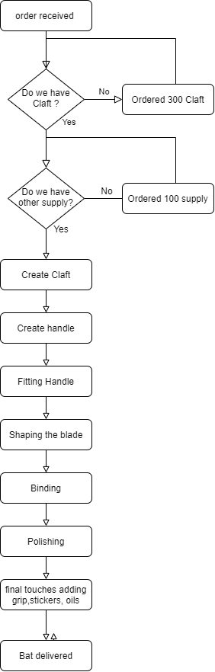
Flow Chart

Slide 4
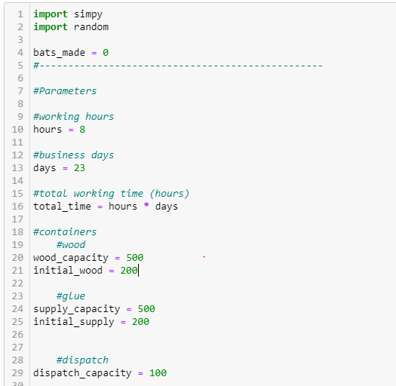
parameter

Slide 5
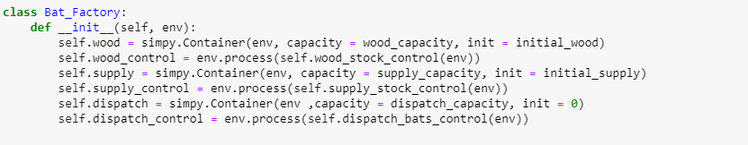
class

Slide 6
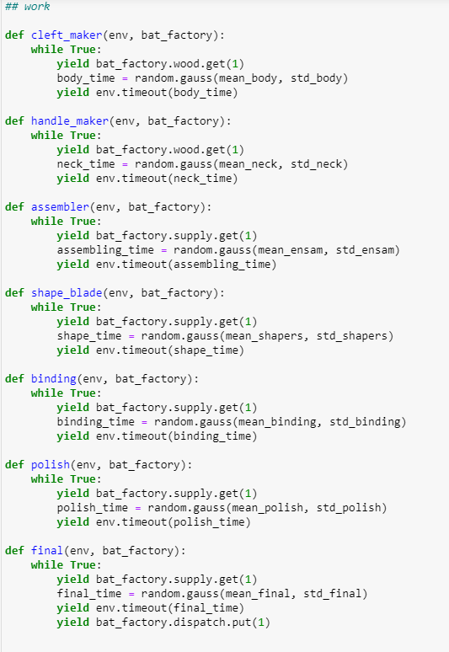
process

Slide 7
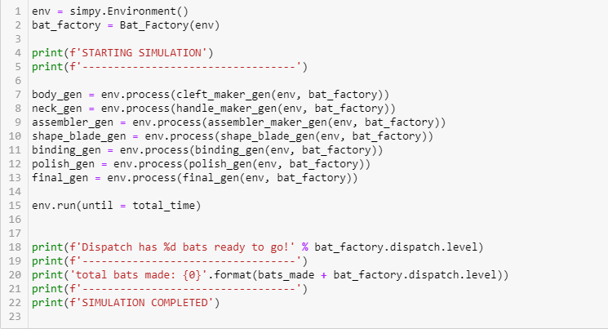
run

Slide 8
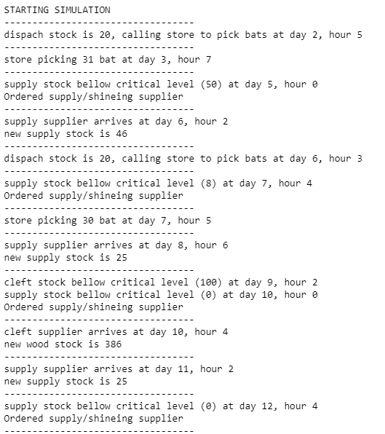
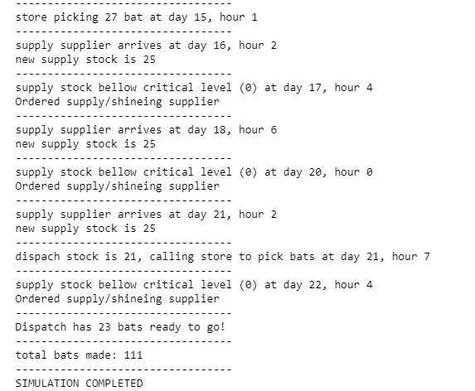
output

Slide 9
conclusion
From the simulation, We can conclude that this small factory can able to delivered the order on time.
This Company can produce 110-120 High quality Cricket Bat with current staff and capacity of supply

